Slide 1


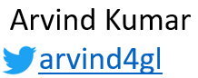
MICROSERVICES DEMO SERIES
REAL TIME
PROJECTS
REAL TIME
PROJECTS
Course Plan

Slide 2
MICROSERVICES DEMO SERIES
REAL TIME
PROJECTS
REAL TIME
PROJECTS
Online shopping portal
Understanding the architecture & technologies to apply

Slide 3







OVERVIEW
PRODUCT
NOTIFICATION
USER MANAGEMENT
FRAUD CHECK
CLIENTS
CART
PAYMENT GATEWAY
ORDER

Slide 4
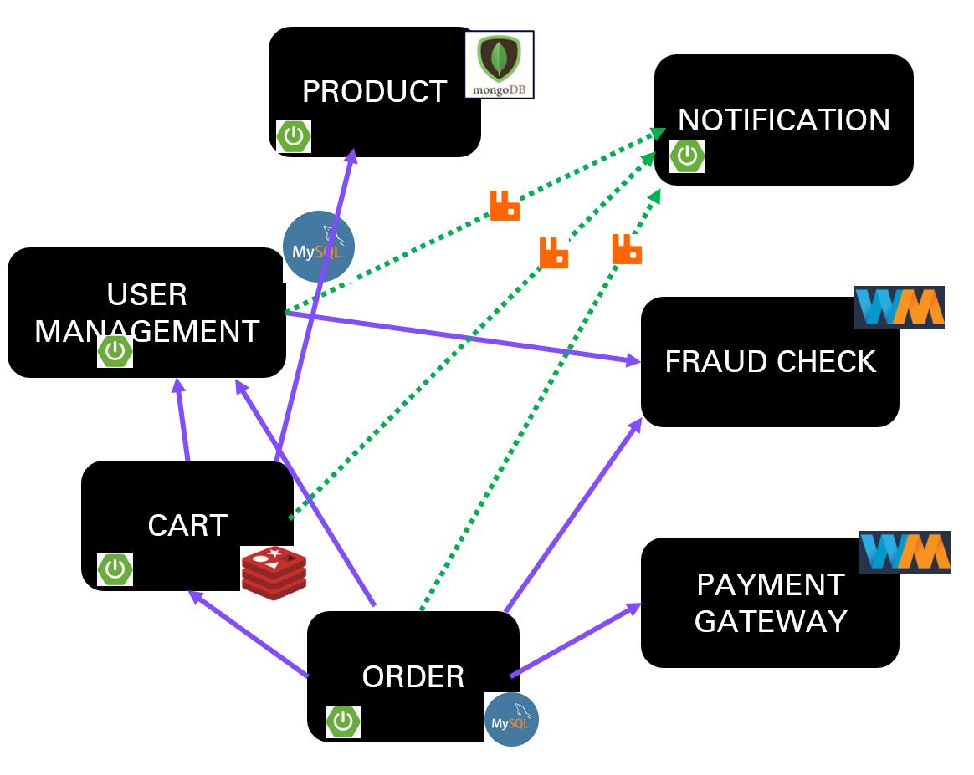
LETS MAKE LIFE OF CLIENTS EASY
LETS MAKE LIFE OF CLIENTS EASY
Centralized config management
A
P
I
G
A
T
E
W
A
Y
CLIENTS
SERVICE REGISTRY & DISCOVERY
LOAD BALANCER

Slide 5

INDIVIDUAL SERVICES STRUCTURE
CREATE
CREATE
ACTUATOR
ACTUATOR
READ
ORDER
SERVICE
READ
CART
SERVICE
CIRCUIT BREAKER
UPDATE
UPDATE
DELETE
DELETE

Slide 6

DATA ARCHIVAL AND PROCESSING
Data Storage/Archival

Slide 7
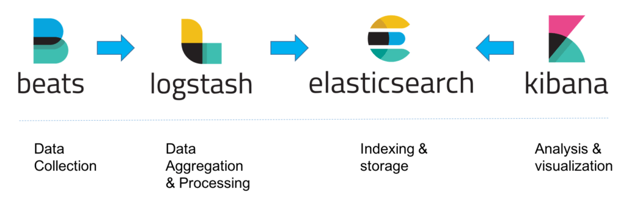
LOG MONITORING – ELK stack

Slide 8



DEPLOYMENT

Slide 9

WRITING CLIENT – FRONT END

Slide 10
THANKS FOR YOUR TIME
https://github.com/greenlearner01/microservices-projects-store/tree/master/Online-Shopping-Portal

Slide 11

MICROSERVICES DEMO SERIES
Product
micro-service
Let's speed up the coding with Lombok & Codota

Slide 12
MICROSERVICES DEMO SERIES
Product
Micro service
REST API data Validation

Slide 13
Product
Microservice
Create
Read
allProducts
productById
productsByCategory
Update
Delete

Slide 14
MICROSERVICES DEMO SERIES
Product
Micro service
Custom exception handling

Slide 15
Topics to be covered
Add business logic to add further validation scenario
Custom exception handler

Slide 16
MICROSERVICES DEMO SERIES
Product
Micro service
Code improvement
&
Hot Code Swapping

Slide 17
Topics to be covered
Hot code swapping to avoid restart on every time code changes
Adding Id of the product autmatically

Slide 18
MICROSERVICES DEMO SERIES
REAL TIME
PROJECTS
REAL TIME
PROJECTS
REAL TIME
PROJECTS
REAL TIME
PROJECTS
Product
Micro service
How to Make things configurable

Slide 19
Topics to be covered
Configure valid currencies
Validate the currency while adding data into the system
Add new currency in the service without changing the code

Slide 20
MICROSERVICES DEMO SERIES
REAL TIME
PROJECTS
REAL TIME
PROJECTS
Product
Micro service
understanding Profiles

Slide 21
Topics to be covered
Add profiles
So that we can jump between dev/test/prod environments
Best practices with profiles
2 ways for profiles
Single file
Multiple profile specific files

Slide 22
MICROSERVICES DEMO SERIES
REAL TIME
PROJECTS
REAL TIME
PROJECTS
Product
Micro service
One place logging with filters
PART 3 OF 3

Slide 23
Topics to be covered
All the request response data to be logged for debugging purposes
Validate and mask the data before logging
Filtering requests to be logged
Logs configuration
Different log levels – TRACE, DEBUG, INFO, WARN, ERROR, FATAL, or OFF
Externalizing logs to external file
Size of the log file
Log file not to be deleted when application restarted
New file created when threshold size is reached

Slide 24
MICROSERVICES DEMO SERIES
REAL TIME
PROJECTS
REAL TIME
PROJECTS
Product
Micro service
Actuator for service monitoring

Slide 25

MICROSERVICES DEMO SERIES
REAL TIME
PROJECTS
REAL TIME
PROJECTS
notification when service status changes
Product Micro service(as client)
Spring boot admin server

Slide 26
MICROSERVICES DEMO SERIES
REAL TIME
PROJECTS
REAL TIME
PROJECTS
Hazelcast for clustering & data persistence
Product Micro service(as client)
Spring boot admin server

Slide 27

Open Source Storage and Computing at In-Memory Speeds
To store your data in RAM, spread and replicate it across a cluster of machines
And performing data-local computation.
Replication gives us resilience to failures of cluster nodes.
©Green Learner - https://youtube.com/greenlearner

Slide 28
2 approaches of data persistence for SBA server
Multiple instances of SBA server with inbuilt Hazelcast dependency
Maintain Hazelcast cluster separately and connect it with SBA server
©Green Learner - https://youtube.com/greenlearner

Slide 29
MICROSERVICES DEMO SERIES
REAL TIME
PROJECTS
REAL TIME
PROJECTS
UI Customization
Product Micro service(as client)
Spring boot admin server

Slide 30
MICROSERVICES DEMO SERIES
REAL TIME
PROJECTS
REAL TIME
PROJECTS
Product Micro service(as client)
Spring boot admin server
Review | Summary

Slide 31
Server Setup
Services registration with SBA
Server
Security
Analysis on what we can do with SBA like changing log levels
Data Persistence
Clients
Notification
UI Customization

Slide 32
MICROSERVICES DEMO SERIES
REAL TIME
PROJECTS
REAL TIME
PROJECTS
REAL TIME
PROJECTS
REAL TIME
PROJECTS
Product
Micro service
Integrating circuit breaker: analysis

Slide 33
Product Microservice

Slide 34
MICROSERVICES DEMO SERIES
REAL TIME
PROJECTS
REAL TIME
PROJECTS
REAL TIME
PROJECTS
REAL TIME
PROJECTS
Product
Micro service
Swagger documentation- customization

Slide 35
MICROSERVICES DEMO SERIES
REAL TIME
PROJECTS
REAL TIME
PROJECTS
REAL TIME
PROJECTS
REAL TIME
PROJECTS
Product
Micro service
Review
&
Next step

Slide 36
Swagger
Endpoints
MongoDB
Circuit breaker analysis
Codota
Product
Microservice
Lombok
Spring boot admin server
Data Validation
Actuators
Custom Exception handling
Hot code swapping
Profiles
Logging

Slide 37

MICROSERVICES DEMO SERIES
REAL TIME
PROJECTS
REAL TIME
PROJECTS
REAL TIME
PROJECTS
REAL TIME
PROJECTS
Product
Micro service
Writing
unit tests

Slide 38
MICROSERVICES DEMO SERIES
REAL TIME
PROJECTS
REAL TIME
PROJECTS
REAL TIME
PROJECTS
REAL TIME
PROJECTS
Product
Micro service
Writing
unit tests - refactoring

Slide 39
MICROSERVICES DEMO SERIES
REAL TIME
PROJECTS
REAL TIME
PROJECTS
REAL TIME
PROJECTS
REAL TIME
PROJECTS
Product
Micro service
Writing
integration tests
@AutoConfigureMockMvc
@SpringBootTest

Slide 40

MICROSERVICES DEMO SERIES
REAL TIME
PROJECTS
REAL TIME
PROJECTS
REAL TIME
PROJECTS
REAL TIME
PROJECTS
Product
Micro service
Code coverage

Slide 41

MICROSERVICES DEMO SERIES
REAL TIME
PROJECTS
REAL TIME
PROJECTS
REAL TIME
PROJECTS
REAL TIME
PROJECTS
Product
Micro service
Static code analysis

Slide 42
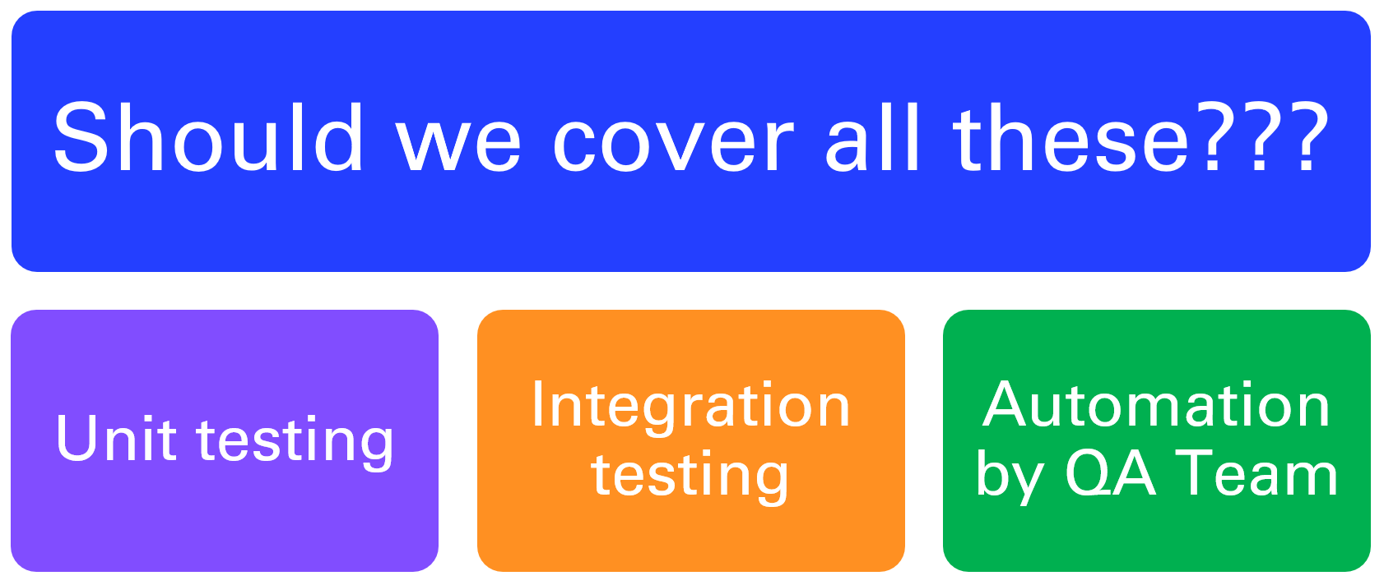

MICROSERVICES DEMO SERIES
Unit Testing
Integration Testing
REAL TIME
PROJECTS
REAL TIME
PROJECTS
Automation by QA team

Slide 43
Unit testing
Integration testing
Automation by QA team

Slide 44
Should we cover all these???
Unit testing
Integration testing
Automation by QA Team

Slide 45
MICROSERVICES DEMO SERIES
REAL TIME
PROJECTS
REAL TIME
PROJECTS
User-Auth
service
architecture
architecture

Slide 46
User Registration
Name
Password
Email
Mobile Number
Role
Verification
User Verification
Email
Token
USER AUTH SERVICE
Find user
email
Token Generation
Email
Password
Token verification
Token String

Slide 47
What we will use in this service
Spring boot
MySQL
Spring Security
OAuth
JWT
Unit & Integration Testing
Registering with spring boot admin server for monitoring

Slide 48
MICROSERVICES DEMO SERIES
REAL TIME
PROJECTS
User Service
Architecture

Slide 49
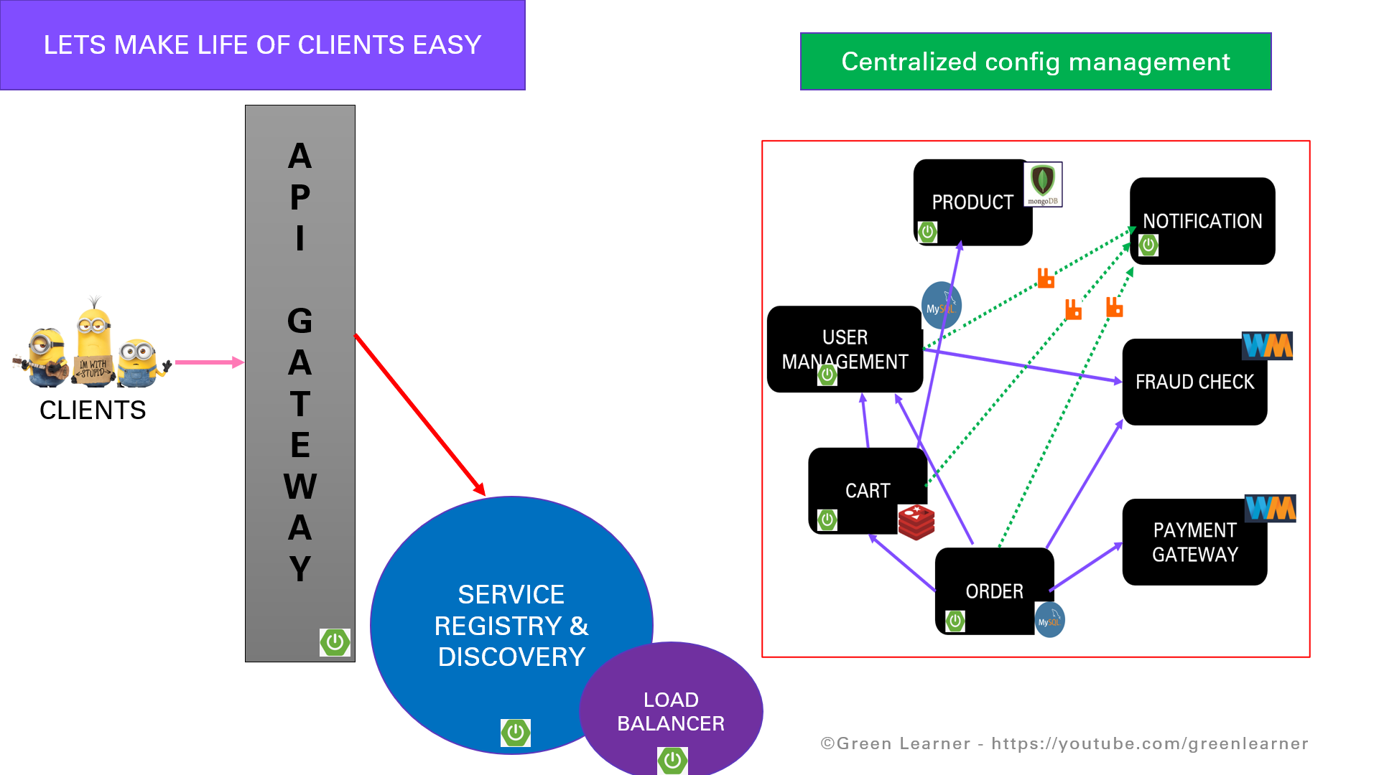

Slide 50
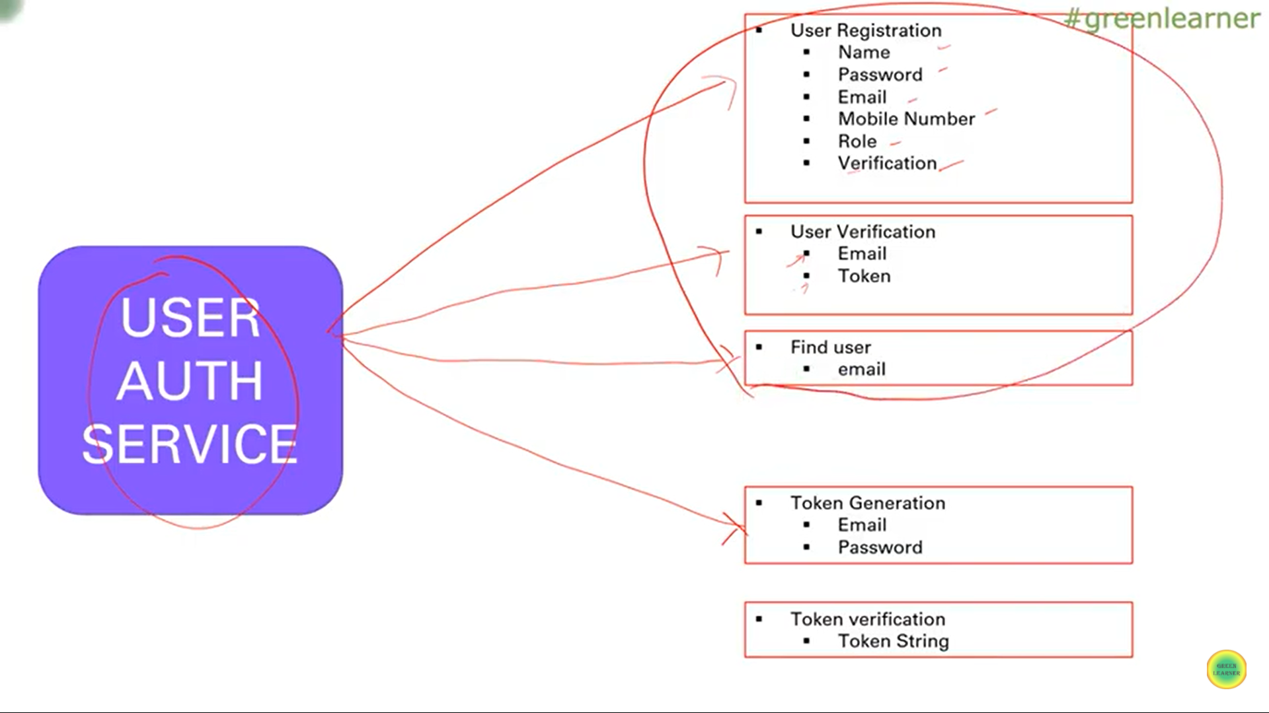

Slide 51
User Auth Service
User Service
User creation related endpoints
Profiles
Password management
Auth Service
Auth related when user tries to login
Token generation
Token storage

Slide 52
Component Diagram

Slide 53
Sequence/Use-case Diagram

Slide 54
Next
Code walk through

Slide 55
MICROSERVICES DEMO SERIES
REAL TIME
PROJECTS
User Service
Hands-On Coding
(MVP- User Registration)

Slide 56

Don’t you think the video is too long for one endpoint??
Yea…
That’s how first project setup takes..

Slide 57
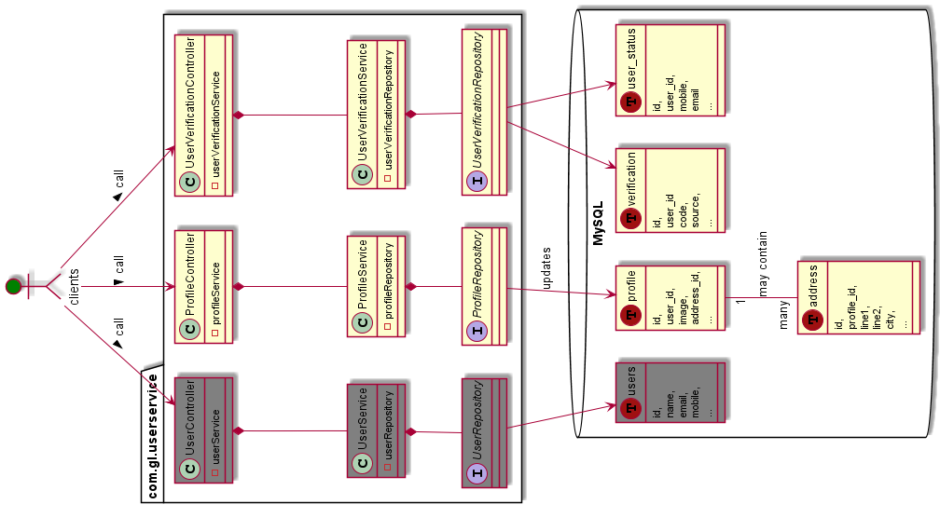

Slide 58
Next
Exception Handling &
Request Validation

Slide 59
MICROSERVICES DEMO SERIES
REAL TIME
PROJECTS
User Service
Request validation
&
Exception handling

Slide 60
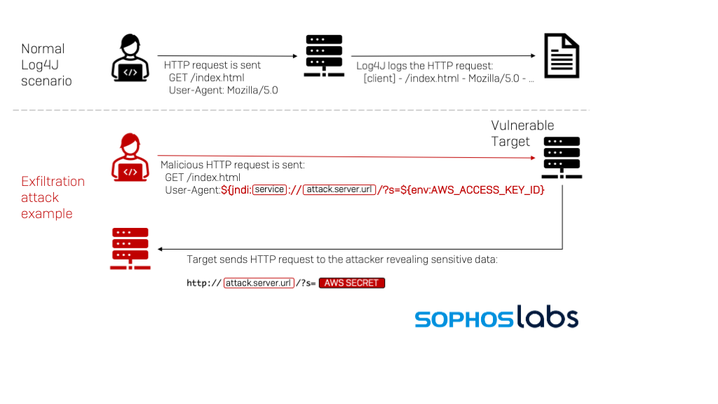

Slide 61
Next
Securing Password

Slide 62
Password storage
Mechanism
&
Best practices

Slide 63
Requirements
Only user must know the password
No internal system should expose the password in plain text
Huge risk of DB hacking and putting all passwords on internet
Difficult to guess
Hard to crack
Hard to reverse engineer

Slide 64
Available options

Slide 65
Encrryption

Slide 66
Hashing

Slide 67
Few Terms related to Secure Hashing

Slide 68
Salting

Slide 69
Peppering

Slide 70
Workfactor

Slide 71
Code Example

Slide 72
Best Practices
Protect databases where the secrets are stored
Hash all the password and use strongest hash function possible
Salt your password(If you are using modern hashed it's automatically done but in case you are on legacy one then make sure to add it)
Pepper the password
Check passwords against dictionary list and common one which are easy to guess
Password length is more important than complexity - details here
Put validation/restriction at every layer, allow only specified attempts after that lock the user.

Slide 73
References
https://cheatsheetseries.owasp.org/cheatsheets/Password_Storage_Cheat_Sheet.html
https://mkyong.com/java/java-password-hashing-with-argon2/
https://crypto.stackexchange.com/questions/45377/why-cant-we-reverse-hashes
https://snyk.io/learn/password-storage-best-practices/

Slide 74
MICROSERVICES DEMO SERIES
REAL TIME
PROJECTS
User Service
Securing password
with hashing

Slide 75
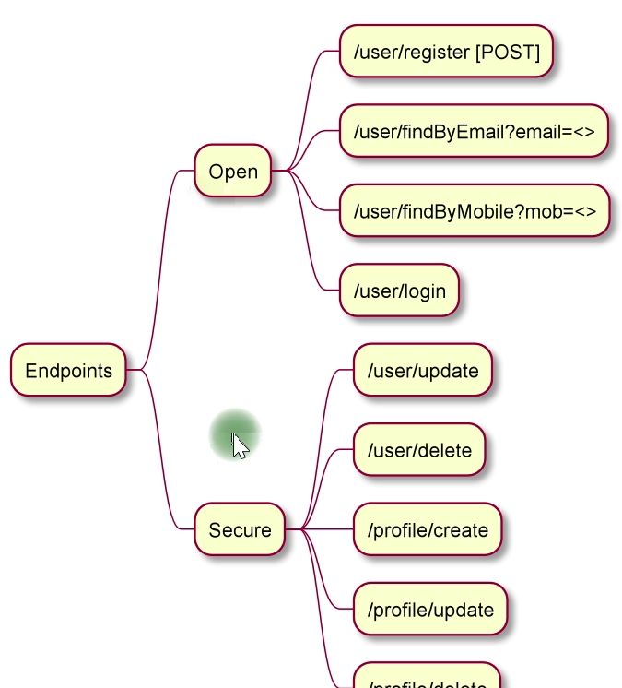
MICROSERVICES DEMO SERIES
REAL TIME
PROJECTS
User Service
authentication/login
Spring security integration

Slide 77
MICROSERVICES DEMO SERIES
REAL TIME
PROJECTS
User Service
Default configuration
Spring security integration

Slide 78
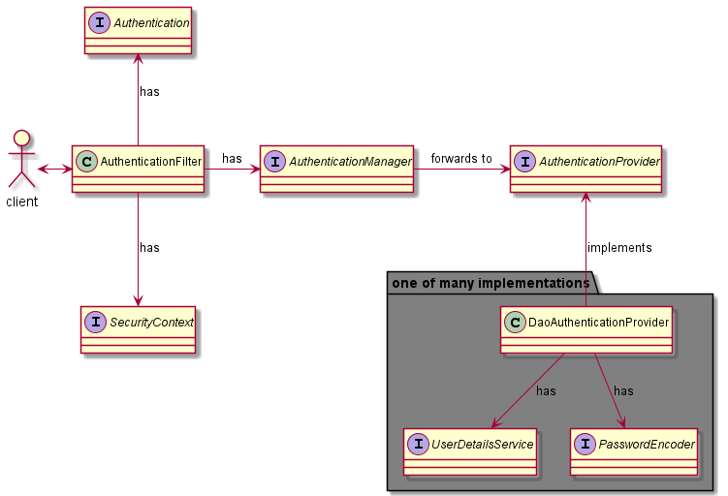
MICROSERVICES DEMO SERIES
REAL TIME
PROJECTS
User Service
How internally works??
Spring security integration

Slide 79
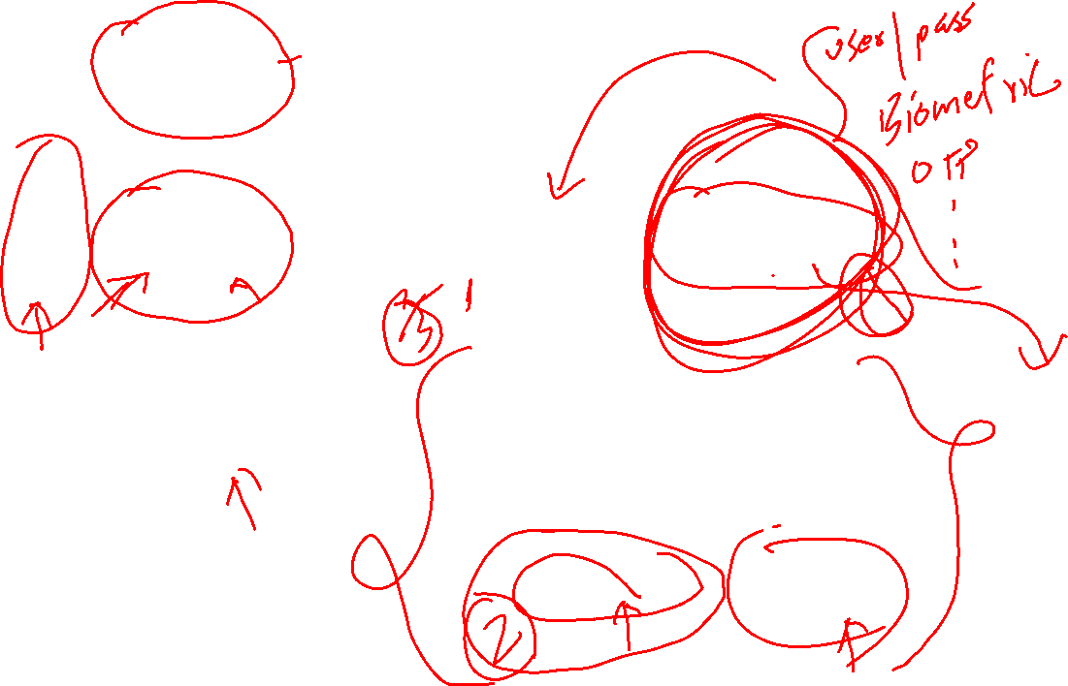

Slide 80
MICROSERVICES DEMO SERIES
REAL TIME
PROJECTS
User Service
Customizing auth-provider
Spring security integration

